Slide 1
Detecting Depression in Arabic Tweets
Dorieh Alomari
Reem Alrayes
Ahmad Hamad

Slide 2
Presentation Outlines:
Introduction and Problem Statement
Previous Work
Final Proposed Approach
The experimental setup
Results, discussion, and outcomes
Implications of the results
Future Work

Slide 3
Introduction and Problem Statement
Depression is a prevalent mental disorder that affects millions of people worldwide.
Rising prevalence of depression in the Arab world
The role of social media in expressing emotions and detecting depression in tweets.
Objective of the project: to build a machine-learning model to detect Arabic tweets with depression tendencies.
Significance of the project: earlier detection of depression and increased awareness about the importance of mental health in the Arab community.

Slide 4
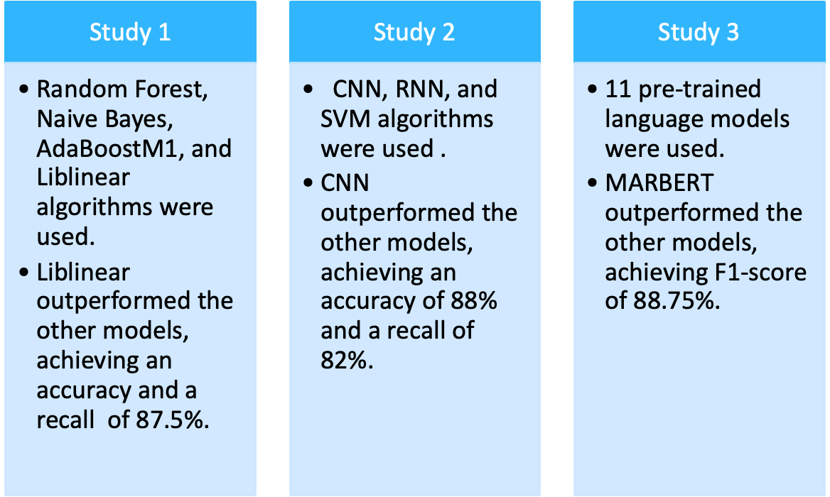
Previous Work

Slide 5
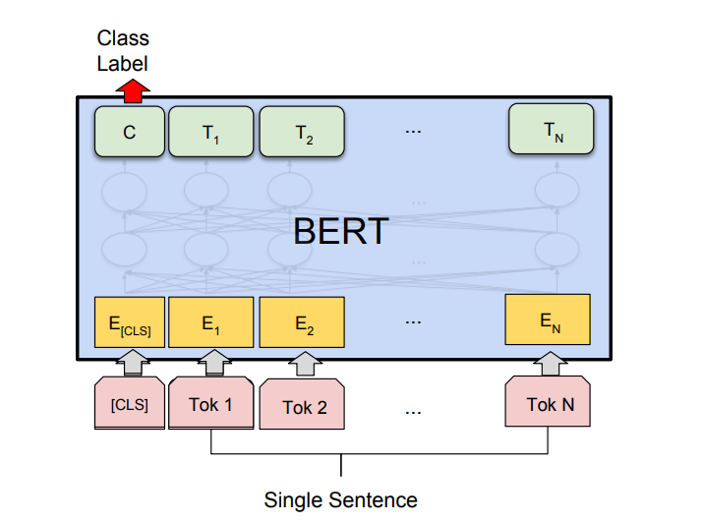
Final proposed approach:
-Model: AraBERTv0.2-Twitter-base.
-For Arabic dialects and tweets.
- Trained on 60M Arabic tweets.

Slide 6
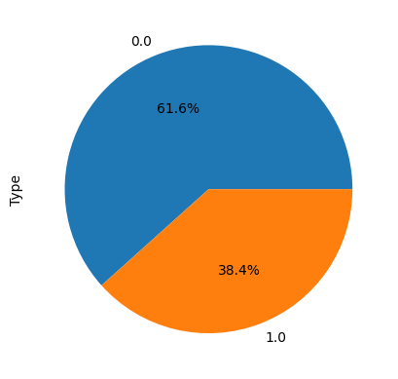
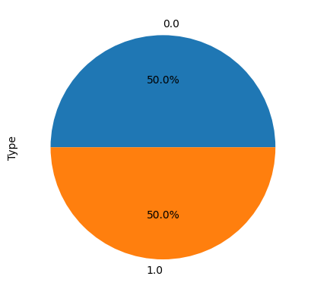
Experimental Setup:
1-Data Collecting
2-Data Preprocessing:
Datasets Integrating.
Dropping duplicate rows.
Dropping Nan rows.
Handling imbalance data: Undersampling
no depression=13088 instances , depression= 8146 instances
Arabert model's preprocessing function was applied to
the dataset.

Slide 7
Experimental Setup:
3-Model fine-tuning:
learning_rate: 2e-05
train_batch_size: 16
seed: 25
optimizer: Adam with betas=(0.9,0.999) and epsilon=1e-08
lr_scheduler_type: linear
num_epochs: 8
4-Evaluation: accuracy, precision, recall, F1-score, and kappa.
5- Deployment: Gradio and HuggingFace.

Slide 8
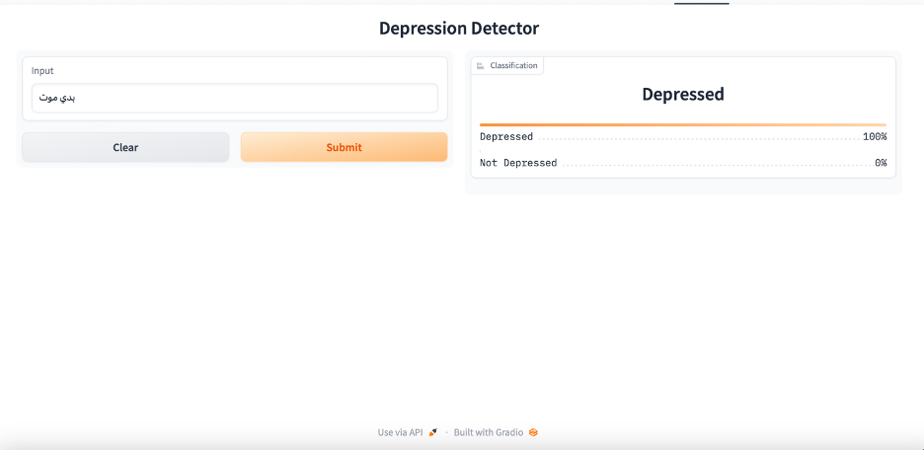
Results and Discussion
Precision | Recall | Accuracy | F1-score | Kappa
0.9281 | 0.9279 | 0.9279 | 0.9279 | 0.8558

Slide 9
ّImplecation of The Results
Companies can check mental health of their employments.
Therapists can check the tweets of their patients to analyze their thoughts.
People can check on their own health before making the decision of starting therapy.

Slide 10
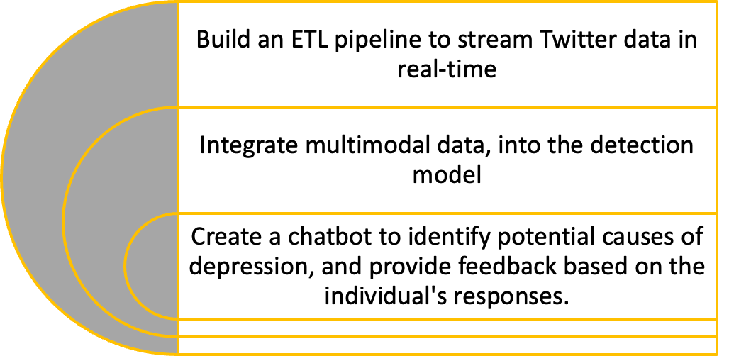
Future Work

Slide 11
References
[1] “Mental disorders.” https://www.who.int/news-room/fact-sheets/detail/mental-disorders (accessed Apr. 15, 2023).
[2] Addcounsel, “Depression in Arabic Countries,” Addcounsel, Apr. 13, 2022. https://addcounsel.com/depression-in-arabic-countries/ (accessed Apr. 15, 2023).
[3] D. H. Naveed, “Mental Health in the Middle East,” Middle East Medical Portal, Sep. 10, 2018. https://www.middleeastmedicalportal.com/mental-health-in-the-middle-east/ (accessed Apr. 15, 2023).
[4] M. R. Islam, M. A. Kabir, A. Ahmed, A. R. M. Kamal, H. Wang, and A. Ulhaq, “Depression detection from social network data using machine learning techniques,” Heal. Inf. Sci. Syst., vol. 6, no. 1, pp. 1–12, Dec. 2018, doi: 10.1007/s13755-018-0046-0.
[5] S. Almouzini and A. Alageel, “2 Salma Almouzini, Maher khemakhem,” Asem Alageel/ Procedia Comput. Sci., vol. 163, pp. 0–000, 2019, doi: 10.1016/j.procs.2019.12.107.
[6] M. El-Ramly et al., “CairoDep: Detecting Depression in Arabic Posts Using BERT Transformers,” Proc. - 2021 IEEE 10th Int. Conf. Intell. Comput. Inf. Syst. ICICIS 2021, pp. 207–212, 2021, doi: 10.1109/ICICIS52592.2021.9694178.
[7] “aubmindlab/bert-base-arabertv02-twitter · Hugging Face,” Apr. 05, 2023. https://huggingface.co/aubmindlab/bert-base-arabertv02-twitter (accessed May 06, 2023).
[8] M. Hassib, N. Hossam, J. Sameh, and M. Torki, “AraDepSu: Detecting Depression and Suicidal Ideation in Arabic Tweets Using Transformers,” in Proceedings of the The Seventh Arabic Natural Language Processing Workshop (WANLP), Abu Dhabi, United Arab Emirates (Hybrid): Association for Computational Linguistics, Dec. 2022, pp. 302–311. [Online]. Available: https://aclanthology.org/2022.wanlp-1.28
[9] alhuri, Depression-detector. 2023. Accessed: May 06, 2023. [Online]. Available: https://github.com/alhuri/Depression-detector
[10] “sklearn.utils.resample,” scikit-learn. https://scikit-learn/stable/modules/generated/sklearn.utils.resample.html (accessed May 06, 2023).

Slide 12
Thank you
Any Questions?

